Slide 1
Implicit Differentiation

Slide 2
Until now, we have been determining derivatives when y is stated explicitly in terms of x.
However, sometimes an equation defines y implicitly as a differentiable function of x. When that happens, we need to differentiate each side of the equation in terms of x, and remember to use the chain rule when differentiating terms containing y.
We may need to use other rules of differentiation as well.

Slide 3
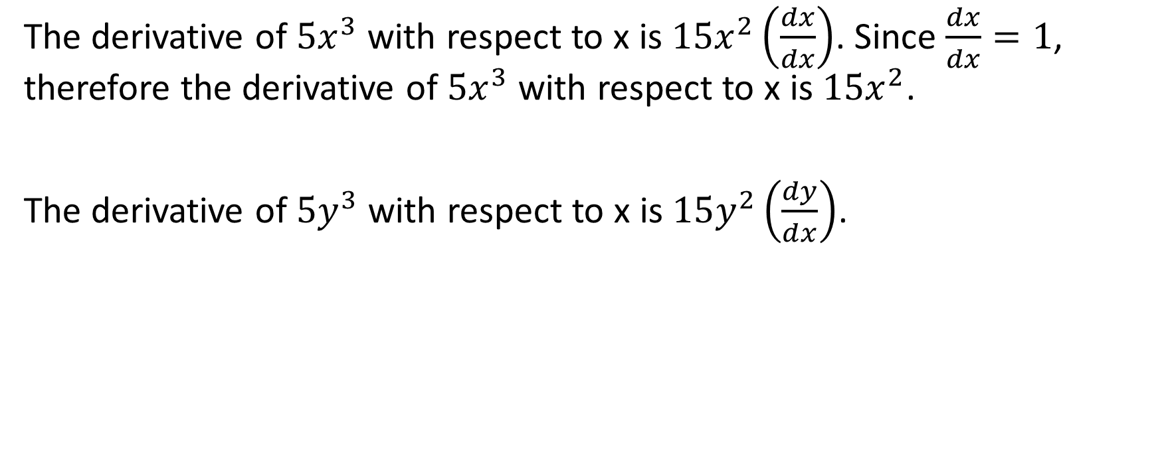
The derivative of $5x^{3}$ with respect to x is $15x^{2}\left(\frac{dx}{dx}\right)$. Since $\frac{dx}{dx}=1$, therefore the derivative of $5x^{3}$ with respect to x is $15x^{2}$.
The derivative of $5y^{3}$ with respect to x is $15y^{2}\left(\frac{dy}{dx}\right)$.

Slide 4

Example
If $x^{2}+y^{2}=25$, determine $\frac{dy}{dx}$ and determine the slope of the tangent to the curve at the point $(3,−4)$.

Slide 5
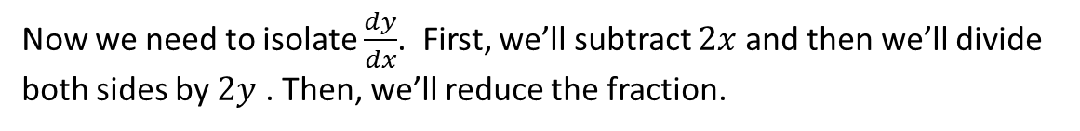
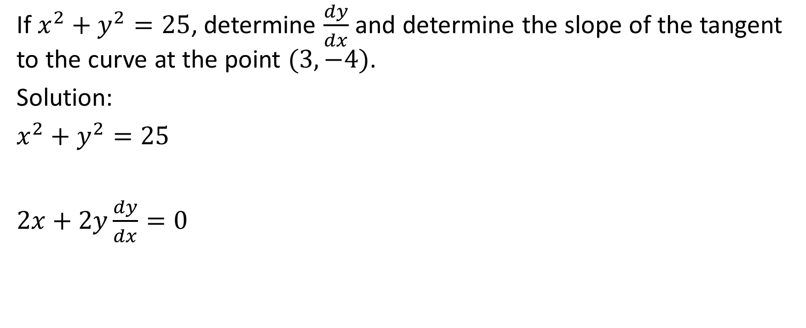
If $x^{2}+y^{2}=25$, determine $\frac{dy}{dx}$ and determine the slope of the tangent to the curve at the point $(3,−4)$.
Solution:
$x^{2}+y^{2}=25$
$2x+2y\frac{dy}{dx}=0$
Differentiate both sides of the equation with respect to x. This means to differentiate each term in the equation with respect to x.
Now we need to isolate $\frac{dy}{dx}$. First, we’ll subtract $2x$ and then we’ll divide both sides by $2y$ . Then, we’ll reduce the fraction.

Slide 6
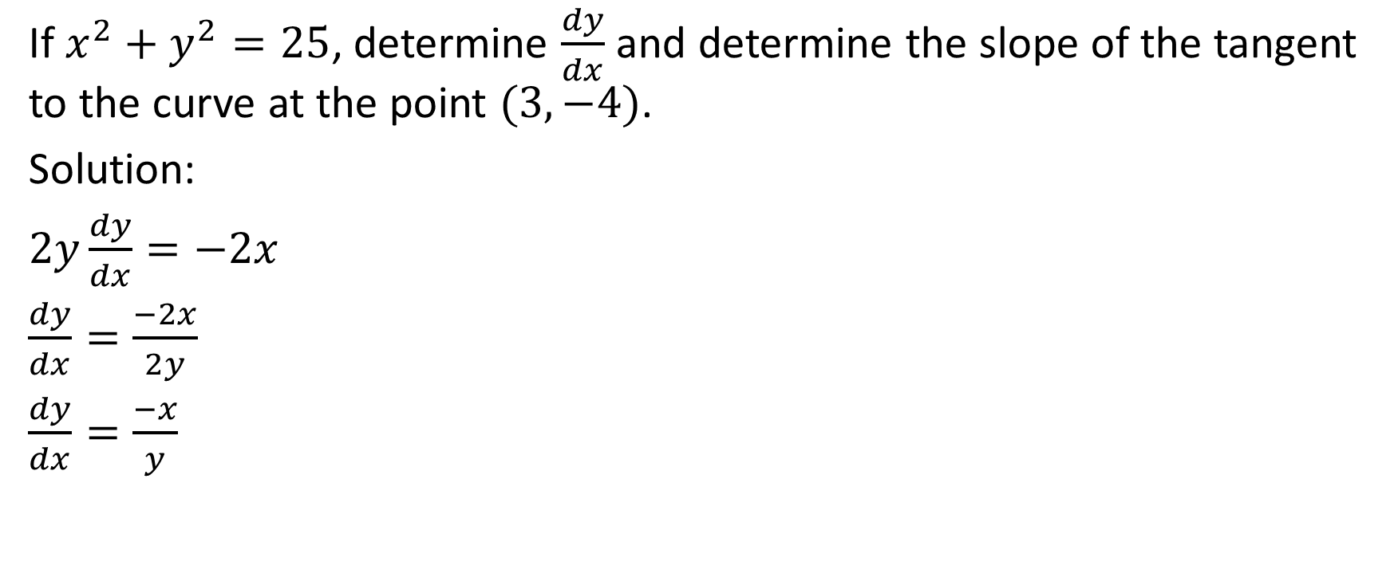
If $x^{2}+y^{2}=25$, determine $\frac{dy}{dx}$ and determine the slope of the tangent to the curve at the point $(3,−4)$.
Solution:
$2y\frac{dy}{dx}=−2x$
$\frac{dy}{dx}=\frac{−2x}{2y}$
$\frac{dy}{dx}=\frac{−x}{y}$

Slide 7
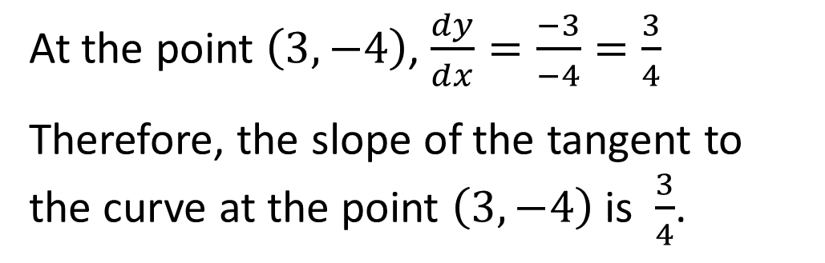
If $x^{2}+y^{2}=25$, determine $\frac{dy}{dx}$ and determine the slope of the tangent to the curve at the point $(3,−4)$.
Solution:
$2y\frac{dy}{dx}=−2x$
$\frac{dy}{dx}=\frac{−2x}{2y}$
$\frac{dy}{dx}=\frac{−x}{y}$
At the point $\left(3,−4\right)$, $\frac{dy}{dx}=\frac{−3}{−4}=\frac{3}{4}$
Therefore, the slope of the tangent to the curve at the point $\left(3,−4\right)$ is $\frac{3}{4}$.

Slide 8

If $x^{2}+y^{2}=25$, determine $\frac{dy}{dx}$ and determine the slope of the tangent to the curve at the point $(3,−4)$.
Solution:
(3,-4)

Slide 9

Example
Determine $\frac{dy}{dx}$ for the relation $6y^{3}−3xy=7$

Slide 10

Determine $\frac{dy}{dx}$ for the relation $6y^{3}−3xy=7$
Solution:
Differentiate both sides.
We will use implicit differentiation on the first term.
We will use the product rule and implicit differentiation on the second term (make sure to put it in brackets because later we will distribute the minus sign).

Slide 11


Determine $\frac{dy}{dx}$ for the relation $6y^{3}−3xy=7$
Solution:
${18y}^{2}\frac{dy}{dx}−\left[3y+3x\frac{dy}{dx}\right]=0$
$18y^{2}\frac{dy}{dx}−3y−3x\frac{dy}{dx}=0$
$18y^{2}\frac{dy}{dx}−3x\frac{dy}{dx}=3y$
Get all of the terms with $\frac{dy}{dx}$ on one side and all of the other terms on the other side
Factor $\frac{dy}{dx}$ from the terms on the left

Slide 12

Determine $\frac{dy}{dx}$ for the relation $6y^{3}−3xy=7$
Solution:
$\frac{dy}{dx}\left(18y^{2}−3x\right)=3y$
$\frac{dy}{dx}=\frac{3y}{18y^{2}−3x}$
Now, we divide both sides by $\left(18y^{2}−3x\right)$ so that we can isolate $\frac{dy}{dx}$
Factor 3 from both numerator and denominator in order to ultimately simplify.

Slide 13

Determine $\frac{dy}{dx}$ for the relation $6y^{3}−3xy=7$
Solution:
$\frac{dy}{dx}=\frac{3(y)}{3(6y^{2}−x)}$
$\frac{dy}{dx}=\frac{y}{6y^{2}−x}$

